Slide 1
Digital Portfolio
STUDENT NAME: KARAN KUMAR S
REGISTER NO AND NMID: 2428B0321 7007E049520E683A7C34FC46A6C80DEA
DEPARTMENT: BSc.COMPUTER SCIENCE WITH DATA ANALYTICS
COLLEGE: KPR COLLEGE OF ARTS SCIENCE AND RESEARCH

Slide 2
PROJECT TITLE
PART-TIME /REAL-LIFE EXPERENCES

Slide 3


AGENDA
Problem Statement
Project Overview
End Users
Tools and Technologies
Portfolio design and Layout
Features and Functionality
Results and Screenshots
Conclusion
Github Link
3/21/2024 Annual Review

Slide 4

PROBLEM STATEMENT
In today’s fast-paced world, students and young individuals often lack a dedicated digital space to reflect on their inspirations and role models. While social media provides exposure, it is cluttered with distractions and does not offer a focused platform to highlight personal values, motivation, and life lessons from great personalities.
There is a need for a simple, interactive, and visually engaging web application where individuals can showcase their role models, explore inspirational quotes, and personalize their choices. Such a platform can help cultivate positive thinking, encourage self-reflection, and motivate users by celebrating the lives and values of great leaders and personalities

Slide 5

PROJECT OVERVIEW
The Inspirations & Role Models Web Application is a simple, interactive website developed using HTML, CSS, and JavaScript. It showcases well-known personalities along with their motivational quotes in colorful card layouts, making the interface visually engaging . Users can highlight their chosen role model, which encourages positivity, self-reflection, and value-based learning. The project also serves as a beginner-friendly practice for understanding the basics of web design, responsive layouts, and interactivity . In the future, the application can be enhanced by allowing users to add their own inspirations, customize layouts, and personalize the experience further, making it more dynamic and user-centered

Slide 6

WHO ARE THE END USERS?
The Inspirations & Role Models Web Application is designed for a wide range of users:
Students & Young Individuals – to explore inspiring personalities and motivational quotes that build confidence, positivity, and self-reflection.
Teachers & Educational Institutions – can use it as a supportive tool to encourage value-based education and discussions on leadership, service, and determination.
General Users – anyone seeking quick motivation and moral support in their daily lives.
Beginner Web Developers – the project serves as a hands-on example for learning HTML, CSS, and JavaScript while creating a meaningful and visually engaging application

Slide 7

TOOLS AND TECHNIQUES
The Inspirations & Role Models Web Application was developed using basic yet powerful front-end technologies:
HTML (HyperText Markup Language): Structures the content and defines elements like headers, cards, and buttons.
CSS (Cascading Style Sheets): Styles the webpage, adds colorful layouts, hover effects, and ensures responsive design across devices.
JavaScript: Provides interactivity such as highlighting the selected role model and displaying user alerts.
Development Tools: Visual Studio Code / Notepad++ for coding; browsers like Chrome, Edge, and Firefox for testing.
Optional Platforms: CodePen / JSFiddle for quick testing and GitHub Pages for hosting and deployment.

Slide 8
POTFOLIO DESIGN AND LAYOUT
The Inspirations & Role Models Web Application follows a clean, colorful, and user-friendly layout designed to engage users while keeping the interface simple.Header Section: Introduces the theme with a bold title for a welcoming start.Main Content: Structured using a responsive grid layout, where each role model is displayed inside a vibrant card.Card Design: Each card includes the personality’s name, motivational quote, and an interactive button.Styling: Smooth hover effects, rounded corners, shadows, and highlights make the design modern and attractive.Responsive Design: Automatically adjusts card arrangements across desktops, tablets, and mobile devices.Aesthetic Appeal: Bright colors, consistent typography, and interactive highlights reflect the motivational theme
8

Slide 9
FEATURES AND FUNCTIONALITY
The Inspirations & Role Models Web Application provides a simple yet interactive platform that highlights motivational personalities and their quotes.
Card-Based Design: Each role model is displayed in an attractive layout with gradients, shadows, and hover effects.
User Interaction: Users can select their inspiration through a button, which highlights the chosen card and displays an alert message.
Responsive Layout: The design automatically adjusts across desktops, tablets, and mobile devices.
Dynamic Interactivity: JavaScript manages highlighting, alerts, and smooth user responses.
Beginner-Friendly Implementation: Combines HTML (structure), CSS (styling), and JavaScript (functionality) for an engaging and educational experience

Slide 10
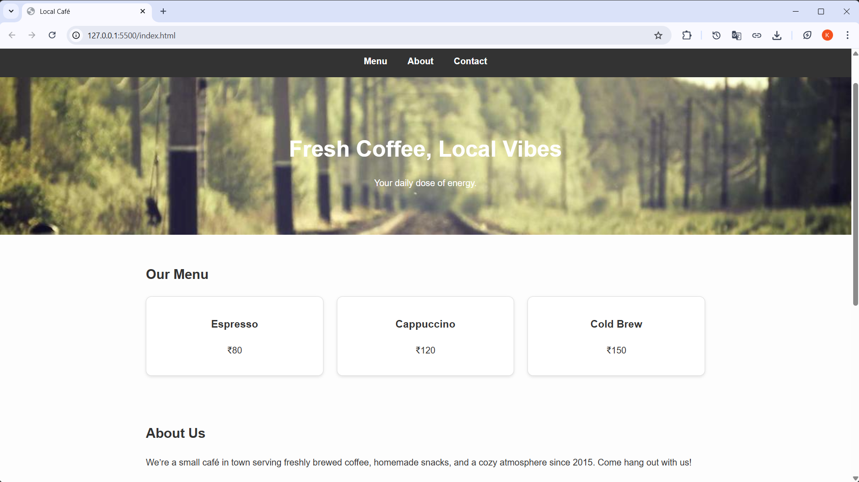

RESULTS AND SCREENSHOTS
3/21/2024 Annual Review
10

Slide 11
CONCLUSION
The Inspirations & Role Models Web Application successfully demonstrates how a simple combination of HTML, CSS, and JavaScript can be used to create an interactive, colorful, and motivational platform.
It allows users to:
Engage with inspirational personalities and their quotes.
Select role models that encourage positivity and self-reflection.
Experience a user-friendly, responsive, and visually appealing interface.
Beyond serving as a motivational platform, the project also acts as a valuable learning exercise for beginners in web development. With future enhancements like adding custom role models or dynamic content, it has the potential to evolve into a more personalized and widely usable application
11

